Slide 1
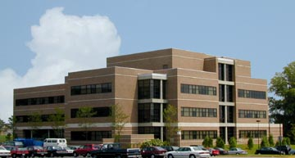
Bioinspired liquid crystal patterns to command living matter
  Oleg D. Lavrentovich
  Advanced Materials and
  Liquid Crystal Institute
  Departments of Physics
  Chemical Physics Interdisciplinary Program
  Kent State University
  Support: NSF DMS-1729509, CMMI-1663394, DOE DE-SC0019105
  APS March Meeting 2020
  Session F18: Non-equilibrium bioinspired modes of assembled materials, March 3, 2020

Slide 2
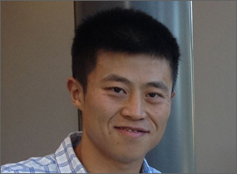
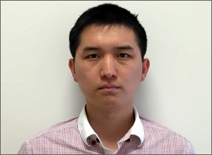
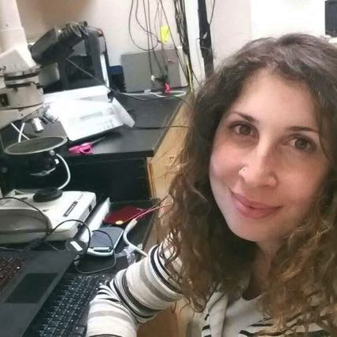

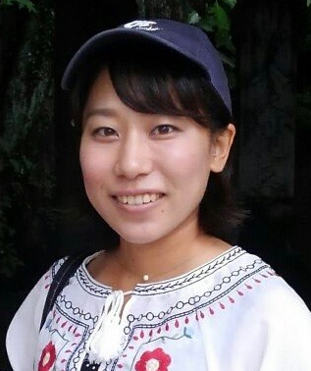
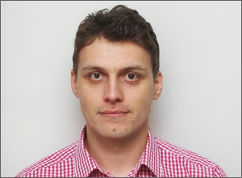
Contributing graduate students, Chemical Physics Interdisciplinary Program
  Shuang Zhou, PhD 2016;
  now Assistant professor at U Mass, Amherst
  Chenhui Peng, PhD 2016;
  now Assistant professor at University of Memphis
Greta Babakhanova,
PhD 2019, now a
researcher at NIST
  Taras Turiv,
  current PhD student
  Bingxiang Li, PhD 2019, now a PDF at AMLCI
  Runa Koizumi,
  current PhD student

Slide 3
Collaborators
Kent State University:
  Dr. Sergij Shiyanovskii, AMLCI
  Dr. Hao Yu and Prof. Qi-Huo Wei, AMLCI, Physics and CPIP
  Miss Jess Krieger and Prof. Min-Ho Kim, Biological Sciences
  Mr. Robert Lastowski, REU student
Our colleagues:
  Prof. Igor Aranson, Department of Biomedical Engineering, Pennsylvania State University
  Mr. Kristian Thijssen and Prof. Julia M. Yeomans, The Rudolf Peierls Centre for Theoretical Physics, Clarendon Laboratory, University of Oxford, UK
  Dr. Amin Doostmohammadi, University of Oxford, now at The Niels Bohr Institute, University of Copenhagen, Denmark
  Dr. Mikhail M. Genkin, Cold Spring Harbor Laboratory

Slide 4
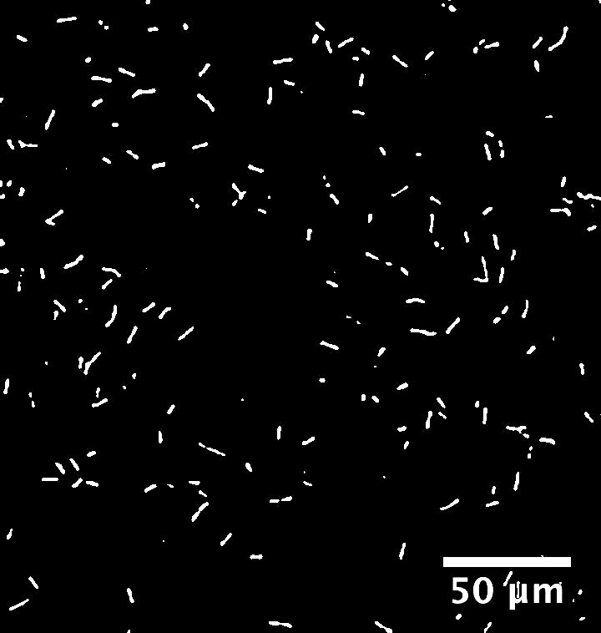
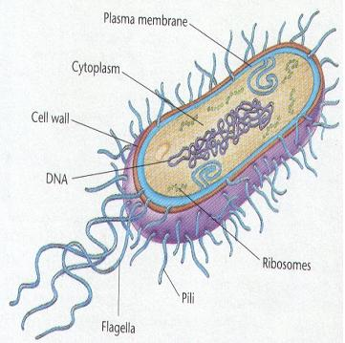
Motivation No.1: Swimming bacteria: Can we extract a useful work from them?
Effective swimmers at microscale, bacteria are “ready-to-use” for microtransport, delivery, mixing
Swimming Bacillus Subtilis
Can we force the swimming bacteria to deliver cargos, drugs, to run micromachines, to transform them into horses of microcosm?
Problem: Visual, audio and tactile communication channels are not available

Slide 5
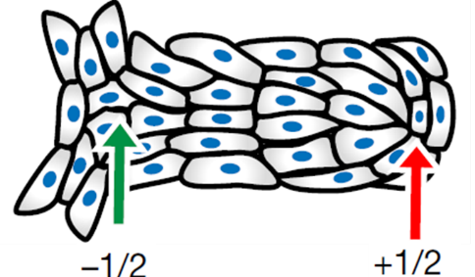
Motivation No.2: Epithelium: Can we design it?
In epithelia, cells form an orientationally ordered nematic with topological defects, T.B. Saw et al, Topological defects in epithelia govern cell death and extrusion, Nature 544, 212 (2017):
+1/2
+1/2
-1/2
Dead cell are extruded at the +½ cores;
The +1/2’s move around in the plane of film
Topological defects are intrinsic to many other active matter systems
Sanchez et al, Nature 491, 431 (2012), Zhou et al, PNAS 111, 1265 (2014)
We do not know where the defects would emerge nor how to control them
Can we develop a template to produce and pin the defects at predesigned locations?

Slide 6
Liquid crystals as guiding and templating medium
This work:
Replace an isotropic aqueous environment natural to many biological microsystems by an orientationally ordered liquid crystal;
Use patterned liquid crystals as a “communication channel” to command swimming bacteria and epithelium patterns

Slide 7
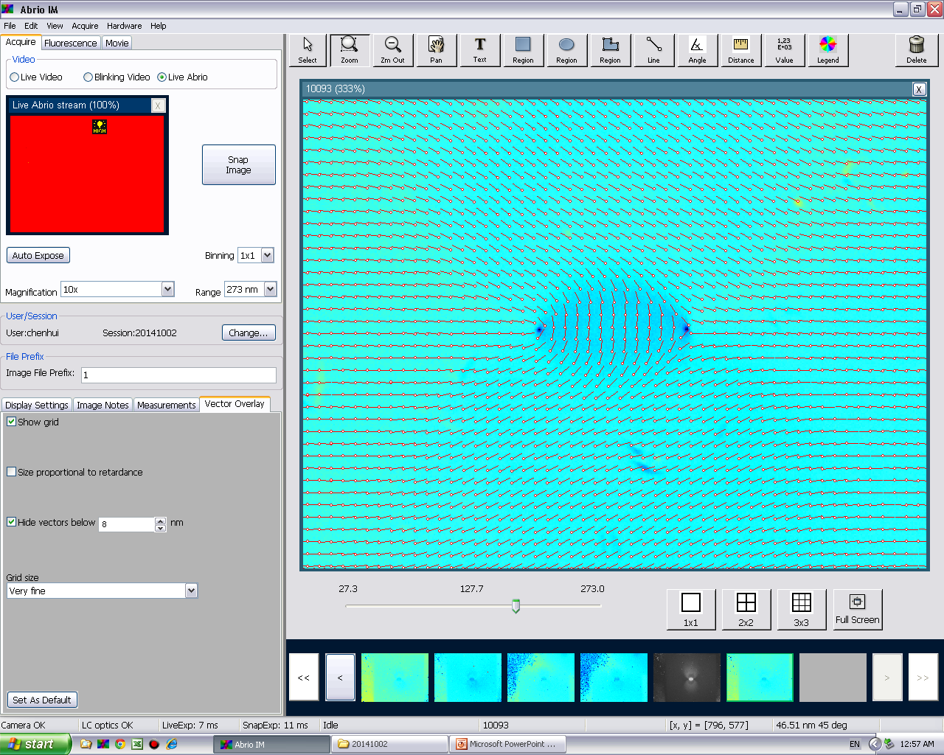
Why liquid crystals are different from water
Anisotropy:
anisotropy axis of dielectric permittivity, viscous drag, birefringence, etc.
Patterning capabilities
Can be prepared as uniformly aligned or as a pattern, using a photoalignment technique

Slide 8
Liquid Crystals to Command Swimming Bacteria
B. Subtilis, swims by rotating helical flagella; activity is controlled by oxygen/nitrogen supply
Chromonic LC
Body:
2-5 μm
10-100 nm
Water based LC, non-toxic for bacteria
  Main feature: an independent control of orientational order and activity

Slide 9
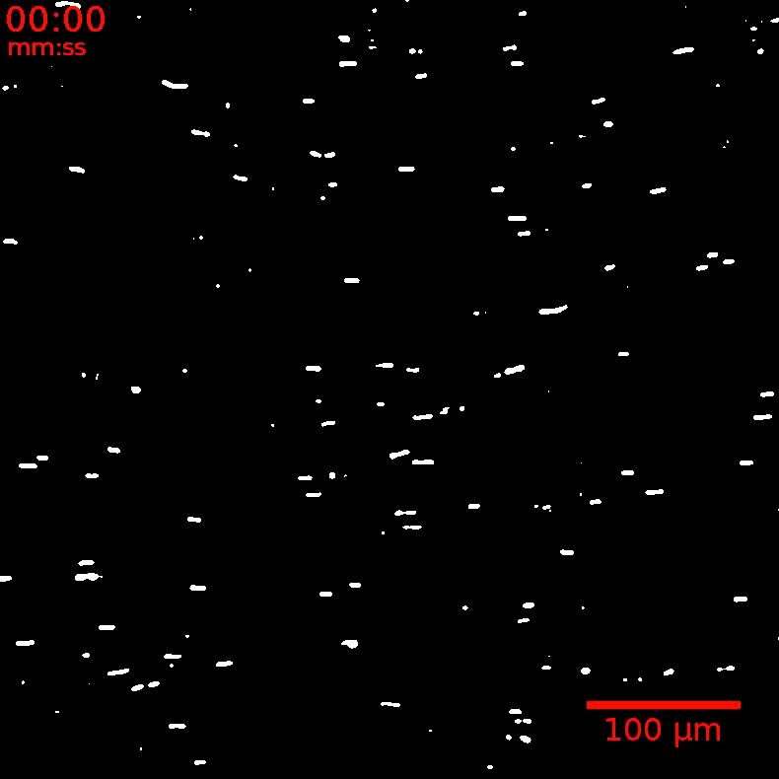
Uniform alignment: bacteria follow the director
Swimming parallel to the director;
no distinction between right and left,
thus no useful work…
S. Zhou et al, PNAS 111, 1265 (2014)

Slide 10

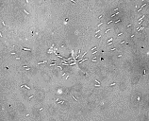
Pure splay: Bacteria swim || director; bipolar motion
c_{B}=10¹⁴ /m³
Number of bacteria swimming towards and away from the core is about the same at low c_{B}
Chenhui Peng, Taras Turiv et al, Science 354, 882 (2016)

Slide 11
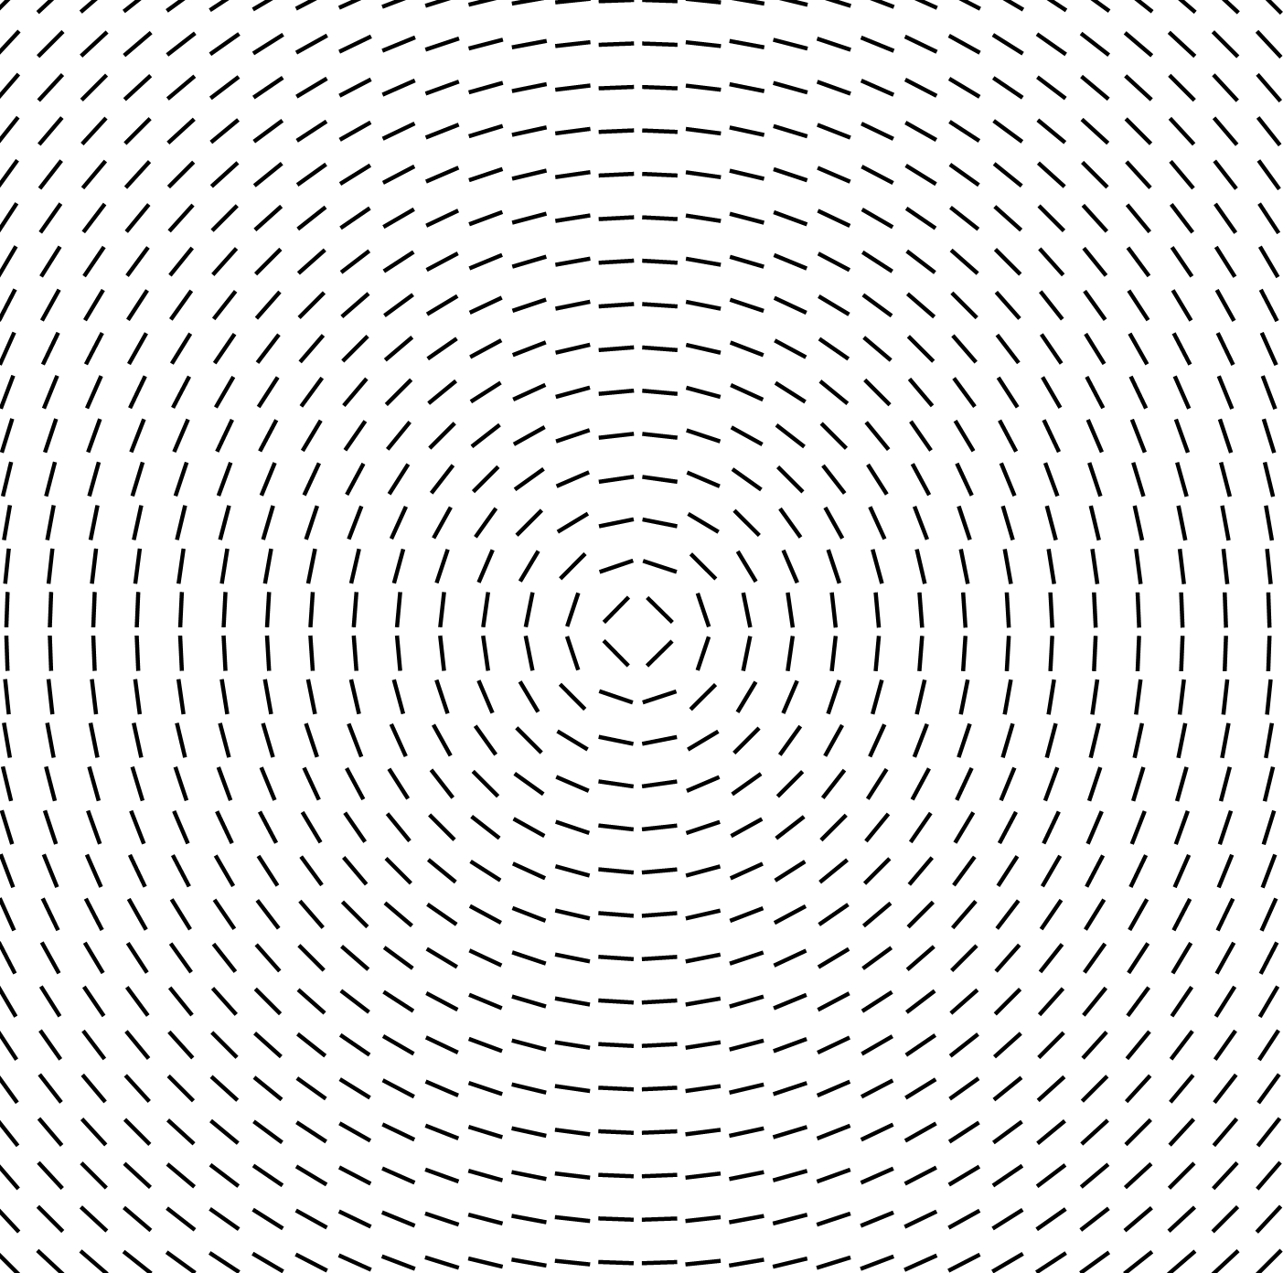
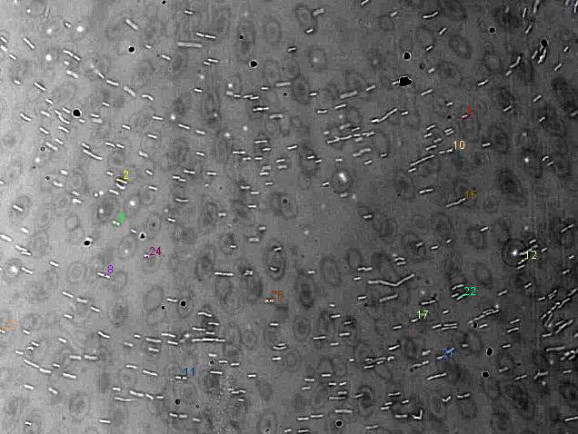
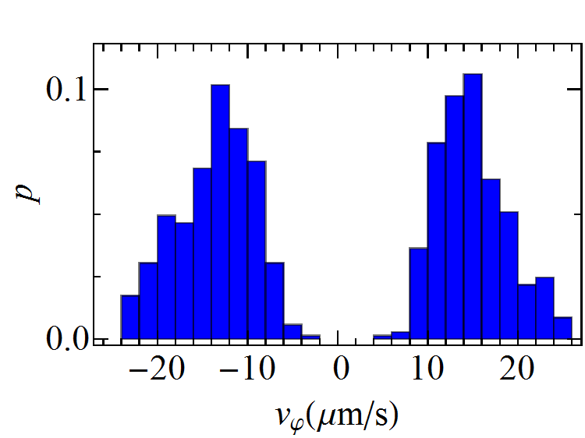
Pure bend: Bacteria swim || director; bipolar motion
c_{B}=10¹⁴ /m³
Number of bacteria swimming to the right and to the left is the same, as expected
Chenhui Peng, Taras Turiv et al, Science 354, 882 (2016)

Slide 12
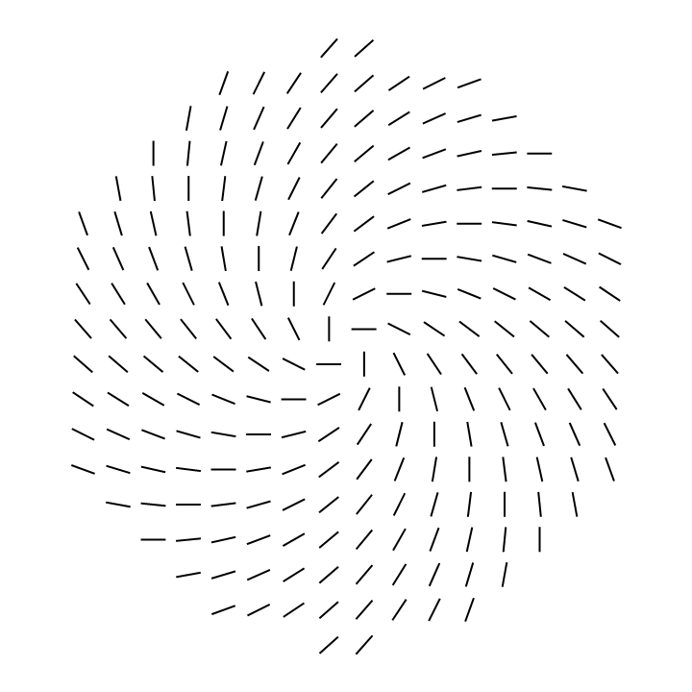
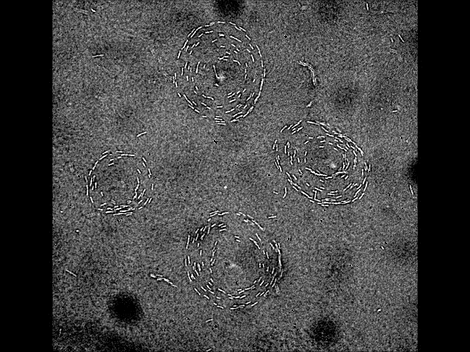
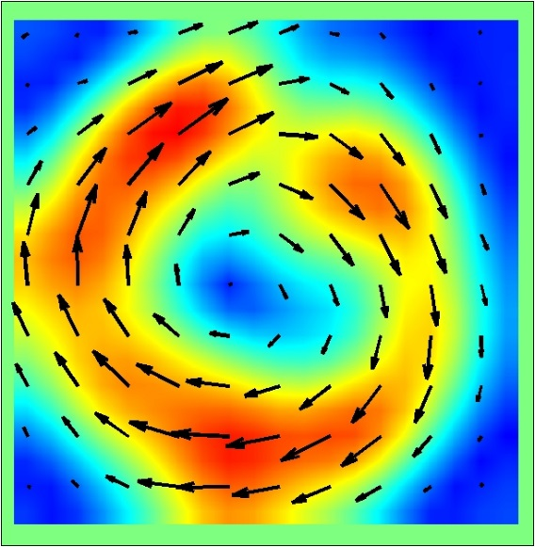
Mixed splay-bend: counterclockwise polar motion
c_{B}=10¹⁴ /m³
Spiral vortex:
Counterclockwise collective circular swimming; strictly polar
Chenhui Peng, Taras Turiv et al, Science 354, 882 (2016)

Slide 13
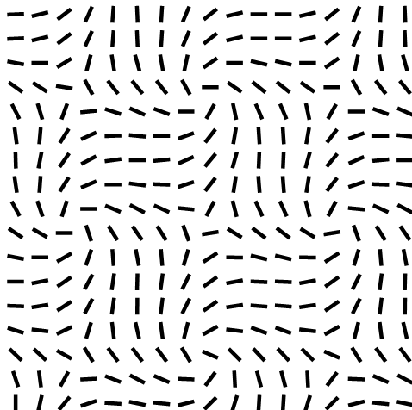
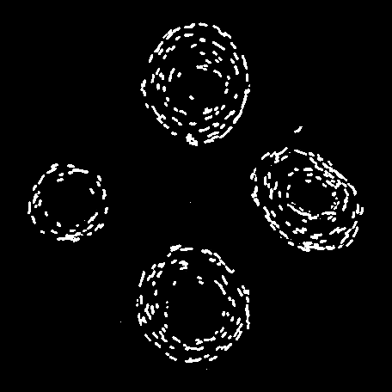
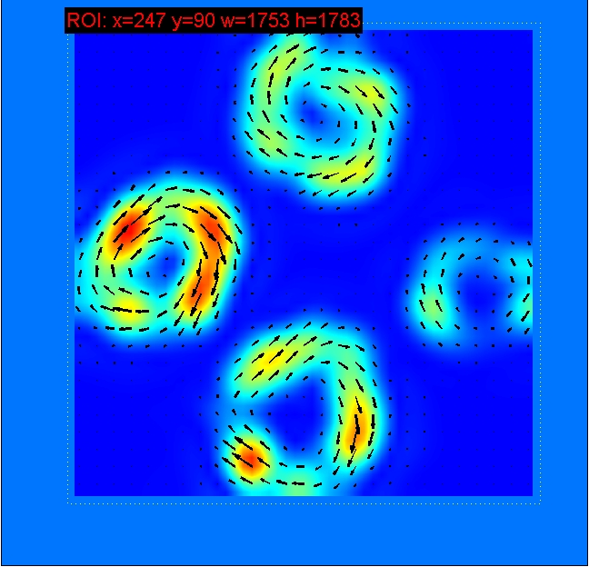
Periodic pattern of -1 and +1 defects: Bacteria gather and circulate around each +1, avoid -1
A, y
+1
+1
Chenhui Peng, Taras Turiv et al, Science 354, 882 (2016)

Slide 14
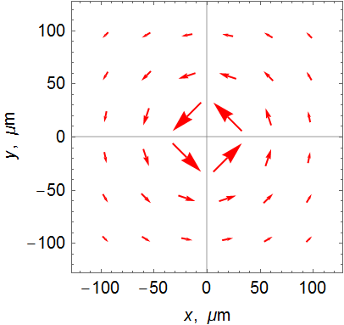
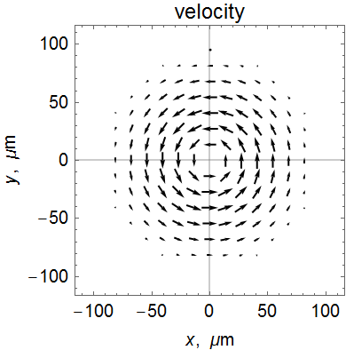
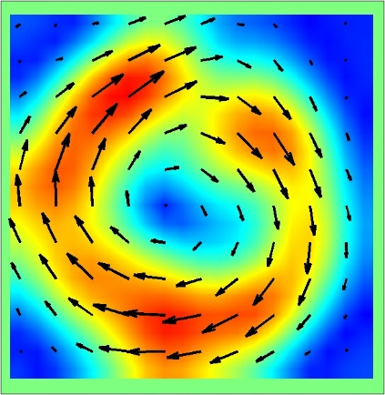
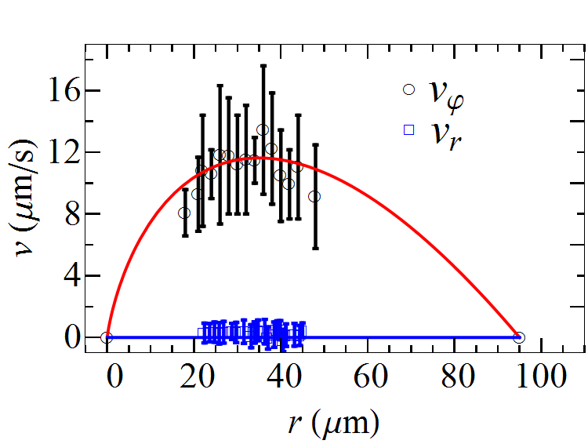
Mechanisms?
Active force
azimuthal force
Opposing viscous force
Balance of drive and drag:
model
experiment

Slide 15
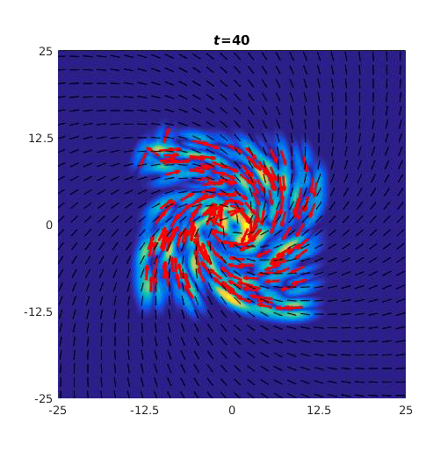
Mixed splay-bend: Forces unipolar circulation
Numerical simulations: Bacteria concentrate into toroidal swirls, concentration varies in space, I. Aranson, T. Turiv, R. Koizumi et al, submitted

Slide 16

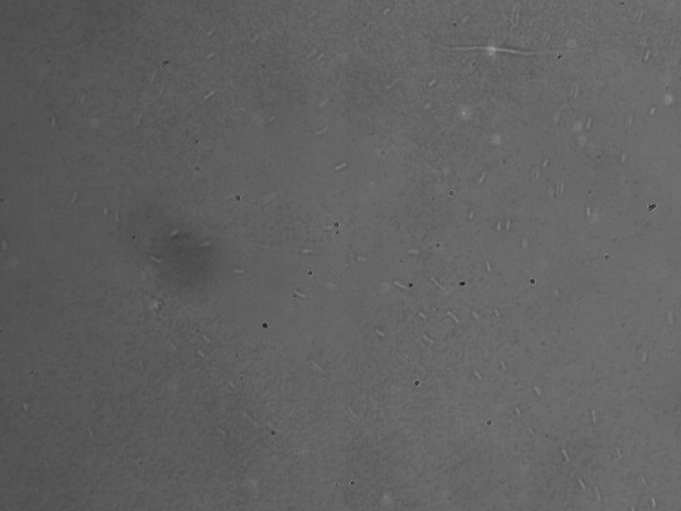
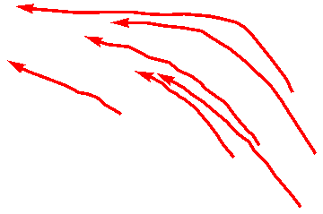
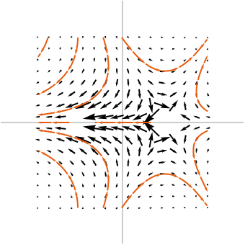
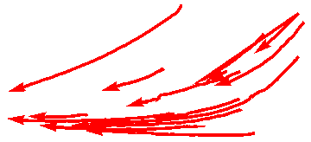
Pumping from -1/2 defect to +1/2 defect
Bacteria concentrate at the cores of +1/2 defects; avoid -1/2 defects
Chenhui Peng, Taras Turiv et al, Science 354, 882 (2016)

Slide 17
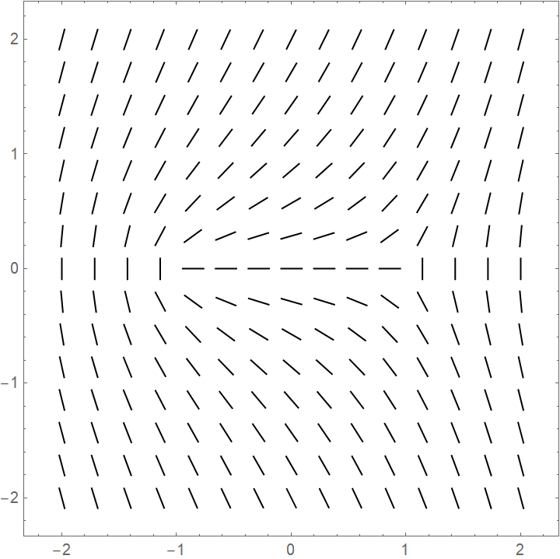
Pumping from -1/2 defect to +1/2 defect
Activity tends to shift the +1/2 defect to the right-hand side

Slide 18
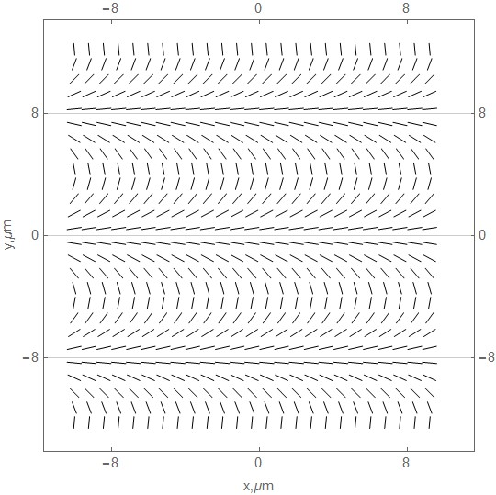
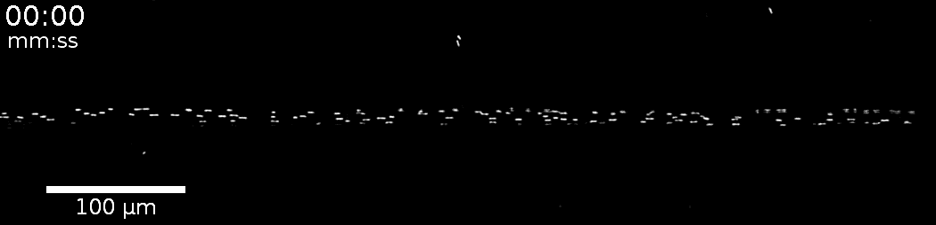
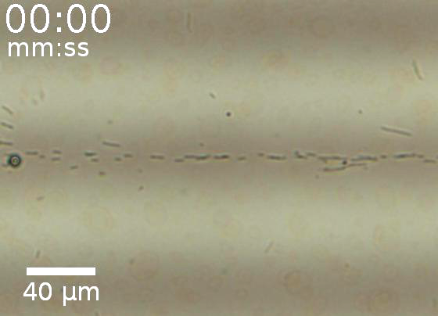
Unipolar swimming in concentrated jets:
Colloidal transport by bacterial jets
T. Turiv, R. Koizumi et al, Nature Physics, March 2, 2020; https://doi.org/10.1038/s41567-020-0793-0

Slide 19
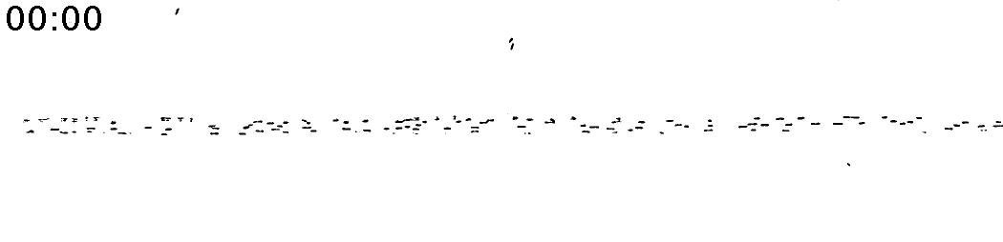
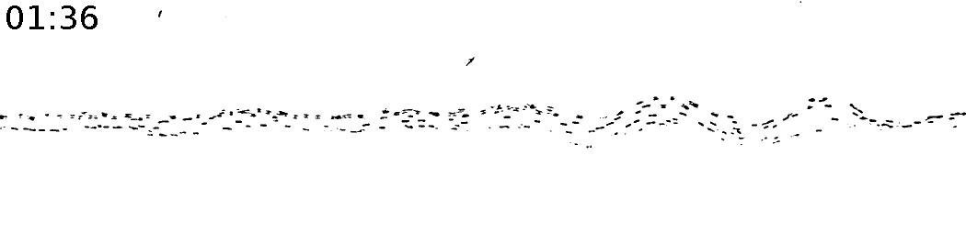
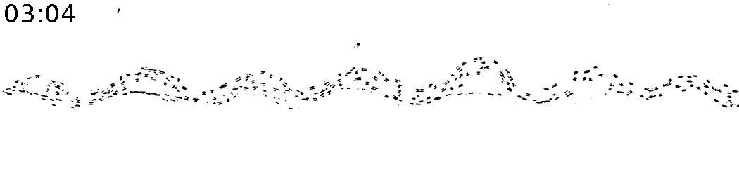
Director bend limits undulations
0 s
As the jets undulate, the angle between the director and the trajectory increases; viscous drag increases and some bacteria are ejected; it helps to keep the period and amplitude of undulations constant;
The jets are stable at c<7c_{critical} where c_{critical} is the critical concentration of instability in a uniform cell
96 s
λ
184 s
100 µm
λ
T. Turiv, R. Koizumi et al, Nature Physics, March 2, 2020; https://doi.org/10.1038/s41567-020-0793-0

Slide 20
Conclusion-I:
Bacteria in patterned nematic:
  Patterns control trajectories, polarity and concentration of bacteria
  Bacterial swirls and condensed jets are unidirectional and thus perform a useful work
  Patterns cause unipolar threshold-less flow of bacteria, circular or linear
  Concentration and thus activity are strongly non-uniform

Slide 21
Motivation No.2: Epithelium: Can we design it?
In epithelia, cells form an orientationally ordered nematic with topological defects, T.B. Saw et al, Topological defects in epithelia govern cell death and extrusion, Nature 544, 212 (2017):
+1/2
+1/2
-1/2
Dead cell are extruded at the +½ cores;
The +1/2’s move around in the plane of film
Topological defects are intrinsic to many other active matter systems
Sanchez et al, Nature 491, 431 (2012), Zhou et al, PNAS 111, 1265 (2014)
We do not know where the defects would emerge nor how to control them
Can we develop a template to produce and pin the defects at predesigned locations?

Slide 22
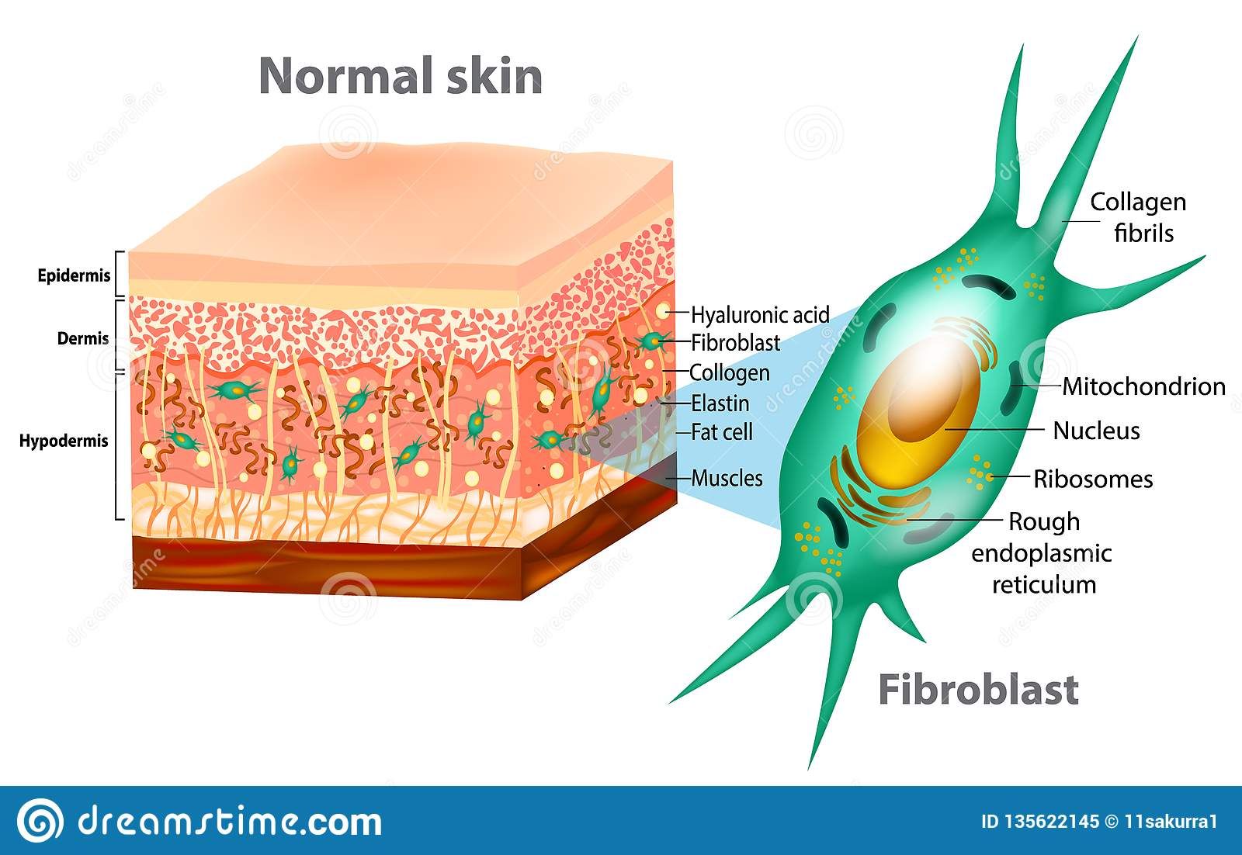
Human dermal fibroblast cells
Fibroblast cells are part of skin responsible for generation of connective tissue and healing wounds

Slide 23
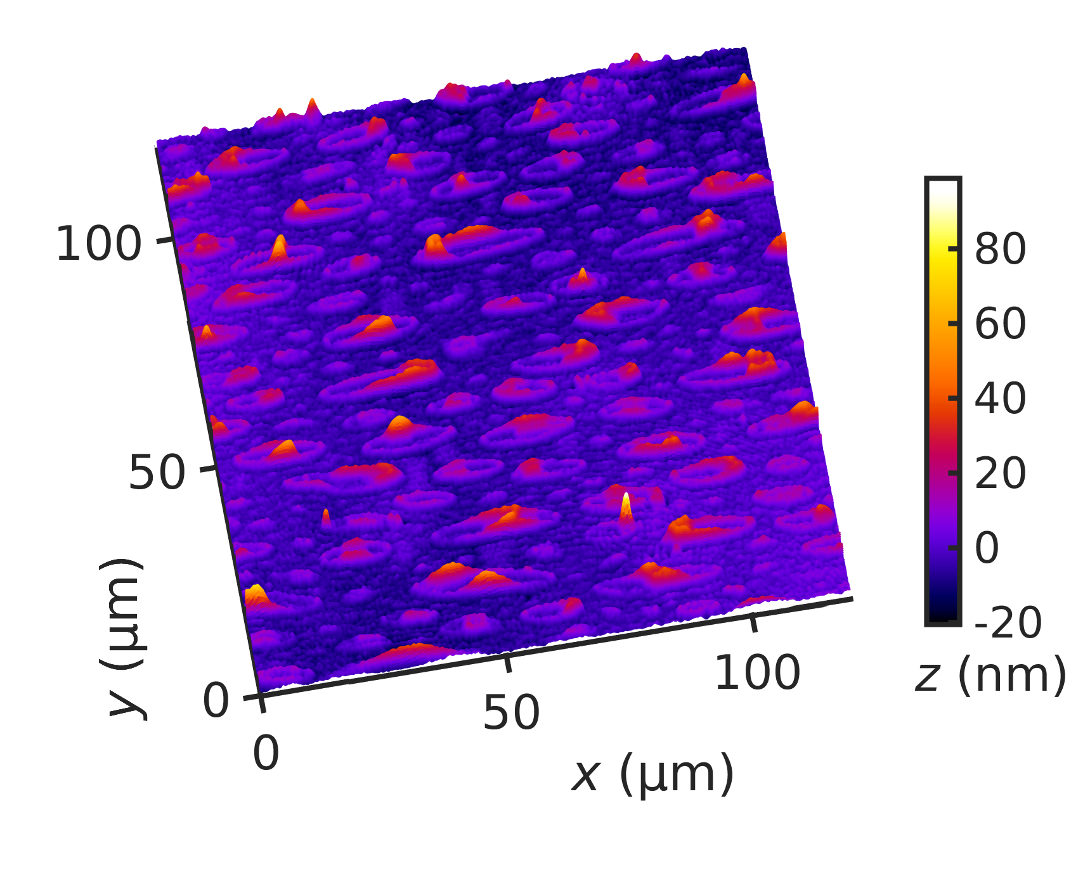
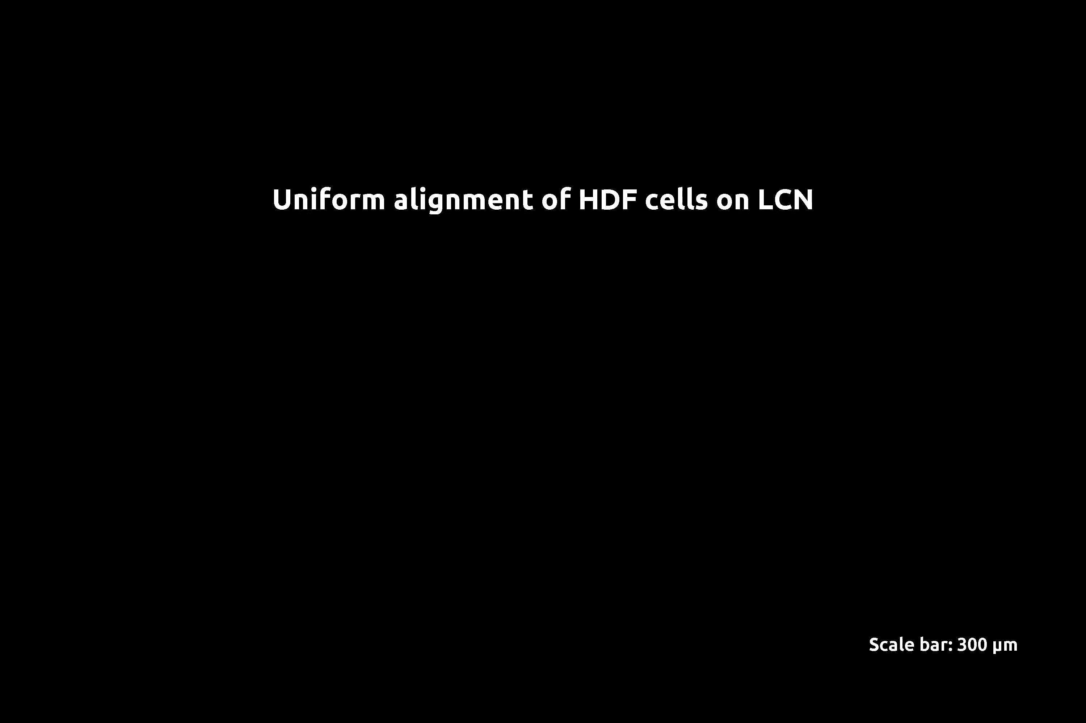
a
b
Alignment of human cells at uniform LCN substrate
Uniform alignment of human dermal fibroblast cells at a uniform LCN substrate
c
Nucleus
Actin filaments
(cytoskeleton)
F_{propulsion}
F_{friction}
LCN
Azo-dye
Glass
T. Turiv, J. Krieger, G. Babakhanova et al, Science Advances, accepted (March 2020)
Notes:
23

Slide 24
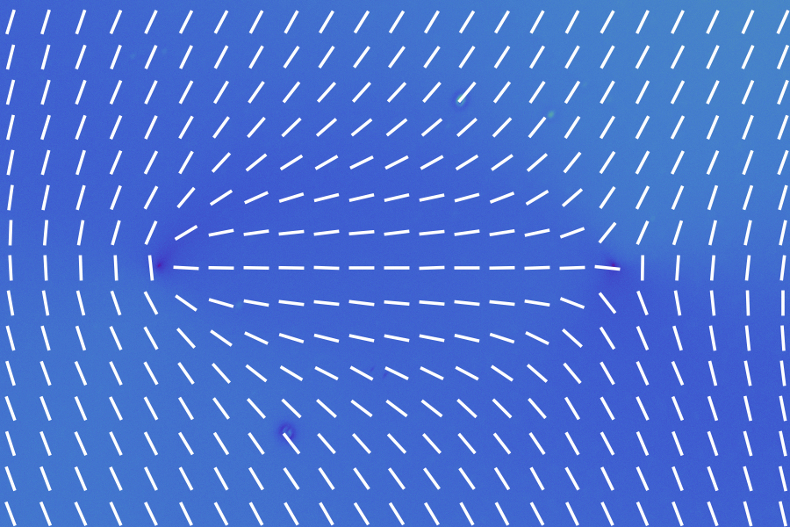
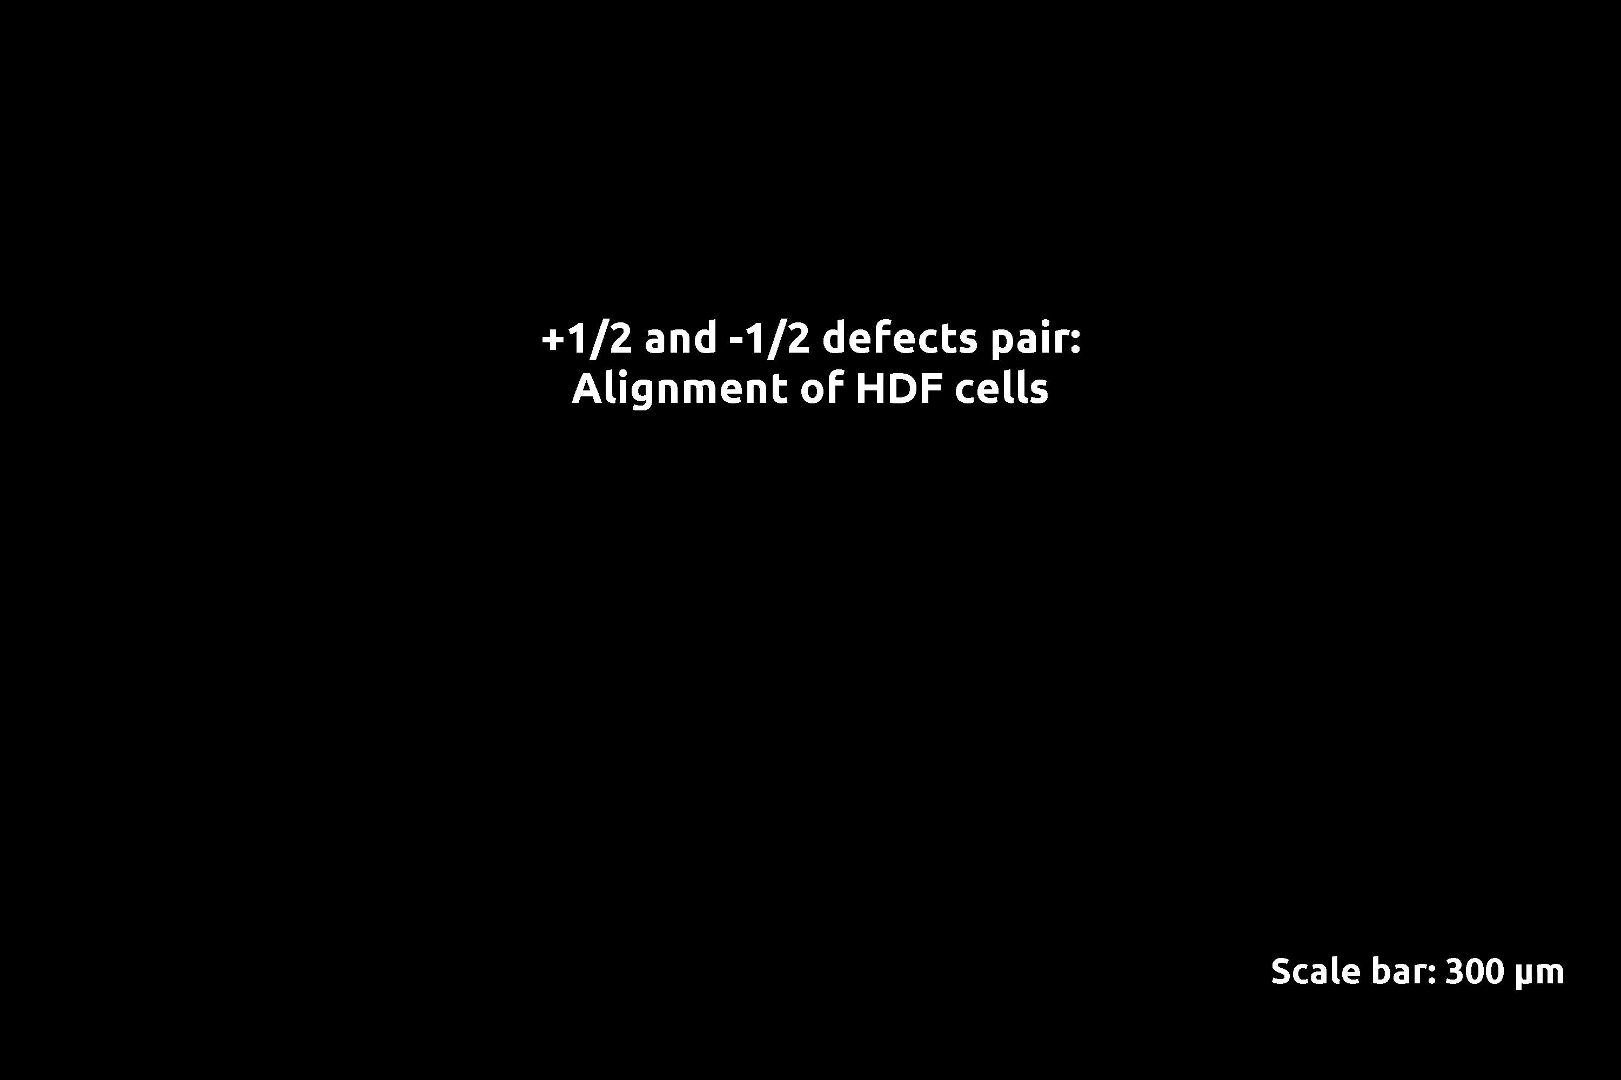

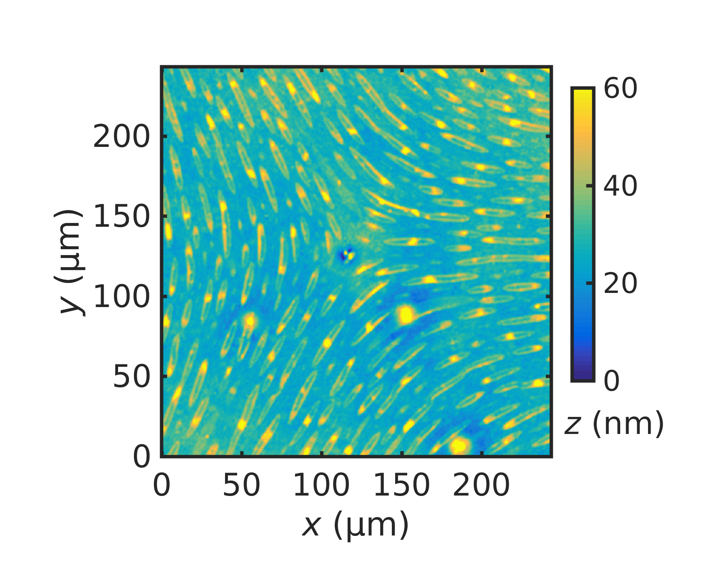
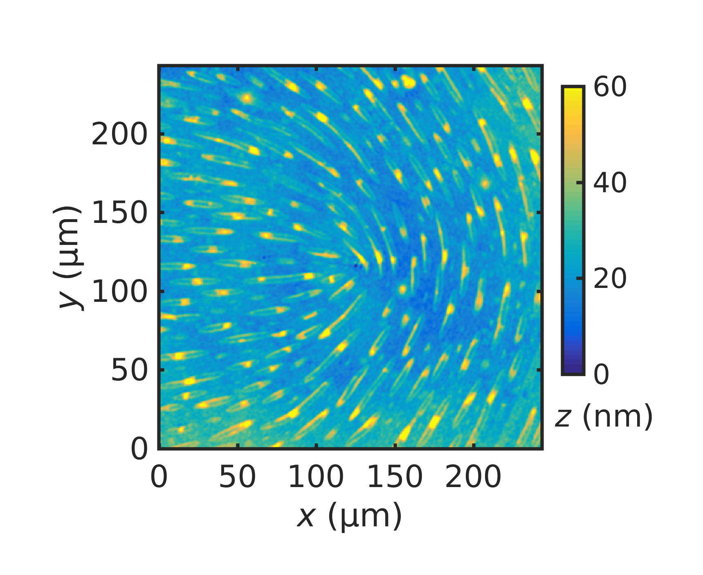
Patterns with +1/2 and -1/2 topological defects
a
0
182 nm
b
c
T. Turiv, J. Krieger, G. Babakhanova et al, Science Advances, accepted (March 2020)
Notes:
24

Slide 25
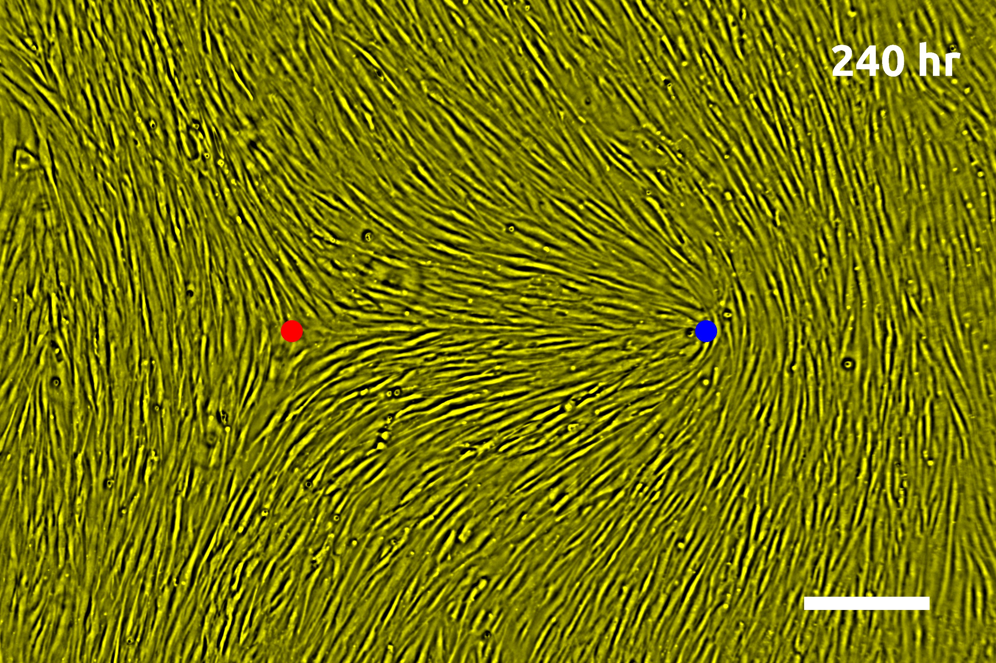
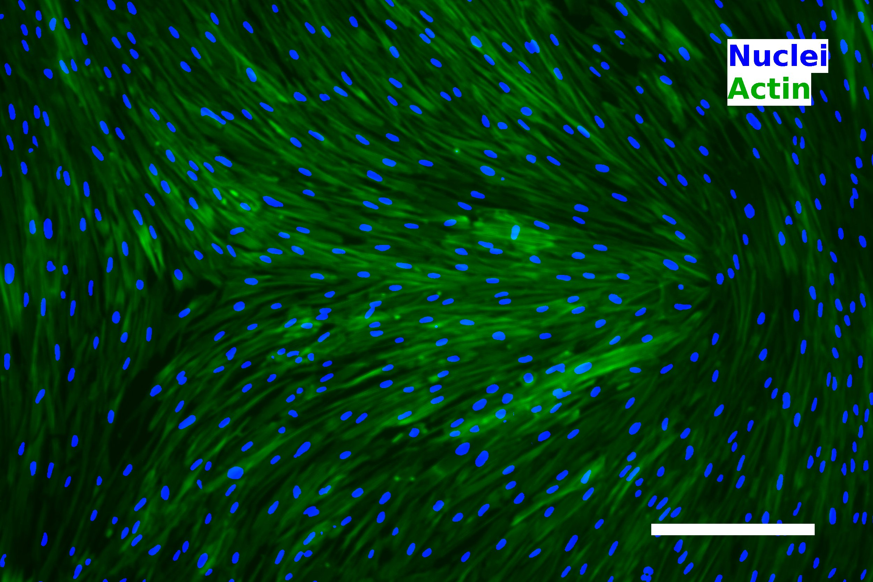
Patterns with +1/2 and -1/2 topological defects
The templated tissue with ½ and -1/2 defects closely resembles the natural epithelium tissue, with that difference that the defects do not leave the predesigned locations.
Notes:
25

Slide 26
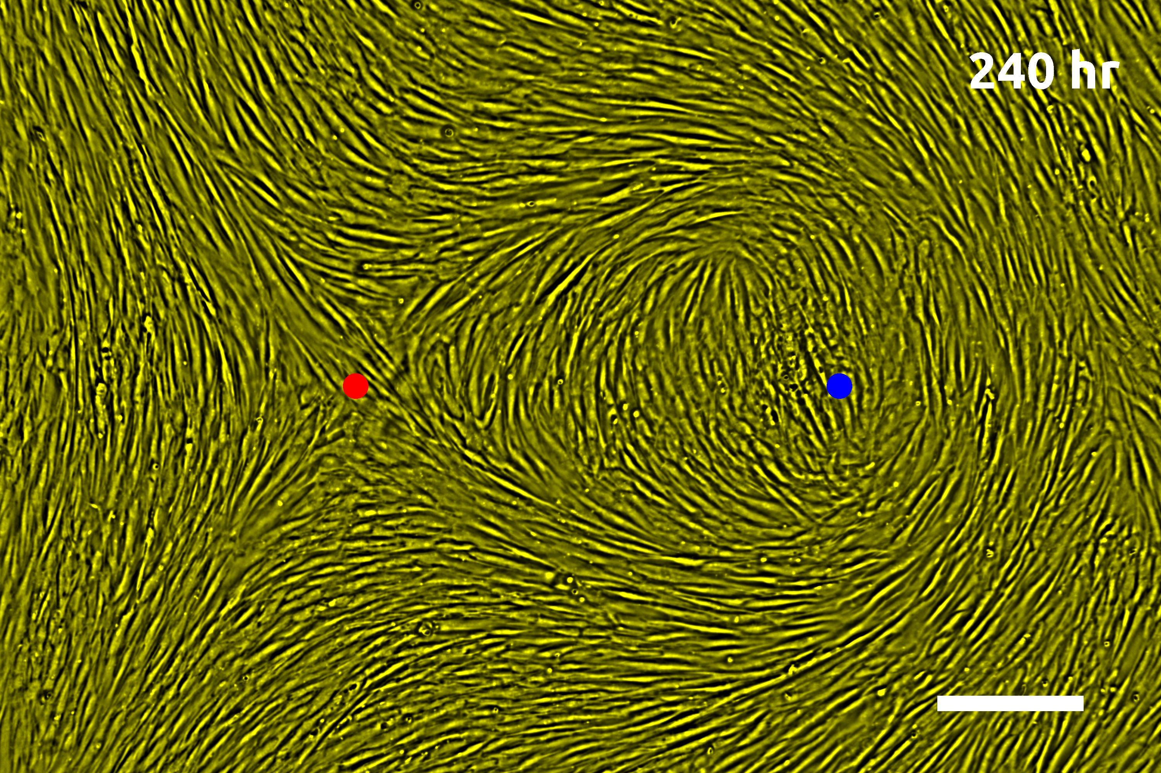
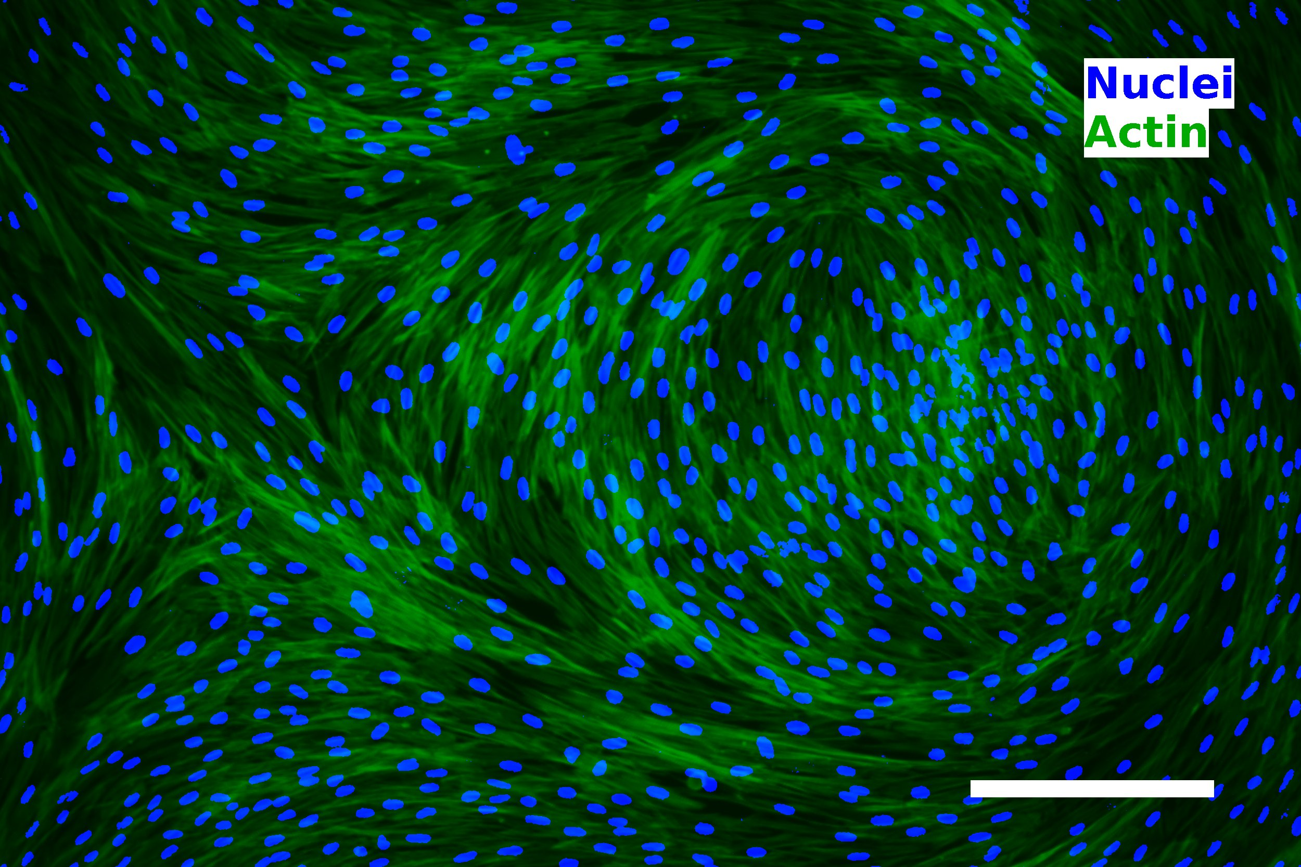
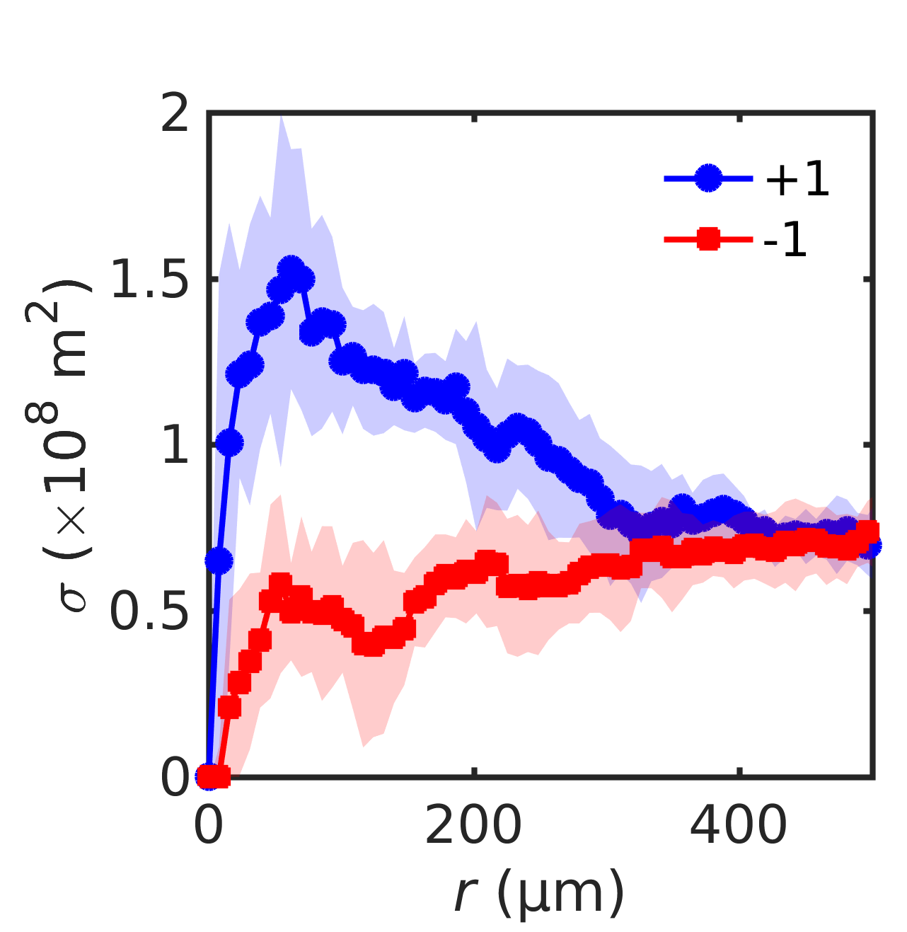
Patterns with +1 circular and -1 defects: Different concentration and phenotype of cells
a
b
All scale bars are 300 µm
+1 defect core attracts high concentration of cells while -1 core depletes them. Since the cells are in contact with each other, variation of density leads to variation in phenotype/shape: length/width ratio =2.6 near +1 defects and =5.8 near -1 defect.
Density of cells
vs radial distance
from the core
T. Turiv, J. Krieger, G. Babakhanova et al, Science Advances, accepted (March 2020)
Notes:
26

Slide 27
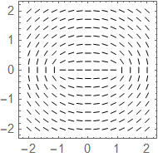



Core splitting of +1 circular defects into pairs of +1/2s
Circular +1 splits into +1/2 defects that move away from each other, which is expected as the elastic energy ~(strength)²;
Note that the -1 defect splitting distance is shorter

Slide 28




Core splitting of +1 circular and radial defects into pairs of +1/2s
Radial +1 splits into +1/2 defects that move towards each other, defying elasticity!

Slide 29


Core splitting of +1 circular and radial defects into pairs of +1/2s
Circular +1 splits into +1/2 defects that move away from each other
Radial +1 splits into +1/2 defects that move towards each other, defying elasticity!
Side-by-side comparison of splitting of +1 circular and radial defects into pairs of ½ defects shows that the distance of splitting is influenced by active forces, in addition to elasticity and surface anchoring
T. Turiv, J. Krieger, G. Babakhanova et al, Science Advances, accepted (March 2020)

Slide 30
Core splitting of +1 radial and circular defects into pairs of +1/2s
Balance of elasticity, surface anchoring and activity:
The experiment suggests that the cells are “pushers”; allows one to estimate tissue parameters such as the anchoring strength W, elastic modulus K and the active force f_{a} from the defect dynamics
T. Turiv, J. Krieger, G. Babakhanova et al, Science Advances, accepted (March 2020)

Slide 31

a
b
Alignment of human dermal fibroblast cells by smectic elastomers
A free surface of a smectic A develops undulations associated with the hybrid character of alignment and the requirement of layers equidistance (a); a mixture of a reactive monomer RM82, smectic A 8OCB and a photoinitiator Irgacure 651 can be polymerized in this undulated state (b,c) with nanogrooves amplitude reaching 25-30 nm (d)
c
G. Babakhanova, J. Krieger et al, J. Biomed. Mater. Rec, DOI: 10.1002/jbm.a.36896 (2020)
Notes:
31

Slide 32

a
b
Alignment of human dermal fibroblast cells by smectic elastomers
Fluorescent microscopy images of hDF grown on substrate a,b) flat glass with fibronectin, c,d) glass with nanogrooved smectic A elastomer. Note the uniform alignment of cells by the smectic A elastomer nanogrooves oriented along the arrows. Scale bars 50 μm.
c
G. Babakhanova, J. Krieger et al, J. Biomed. Mater. Rec, DOI: 10.1002/jbm.a.36896 (2020)
Notes:
32

Slide 33

a
b
Alignment of human dermal fibroblast cells by smectic elastomers
Comparison of actin filament orientation by nanogrooved smectic A elastomer and by flat surface. Scale bars 50 μm.
c
G. Babakhanova, J. Krieger et al, J. Biomed. Mater. Rec, DOI: 10.1002/jbm.a.36896 (2020)
Notes:
33

Slide 34
Conclusion-II
Liquid crystal elastomer coatings of nematic and smectic A type control human dermal fibroblast tissues
  Patterned LC network in contact with aqueous solution produces elevations that guide patterned growth of cells
  Undulation instability of smectic A elastomer creates nanogrooves for cell alignment
  Human dermal fibroblast tissues follow the predesigned LC network and behave as extensile active matter with +1/2 defects moving in the plane of the tissue
  Patterns define the concentration and phenotype of cells
  Difference in the splitting distance of the cores of radial and circular defects allows one to estimate the Frank elastic modulus of the tissue, surface anchoring and the active force

Slide 35
Summary
Patterned liquid crystals can control trajectories, polarity of swimming and concentration distribution of swimming bacteria
Patterned liquid crystal polymers can be used to design arrays of biological cells with predetermined locations of topological defects

